Slide 1

Dissertation – Week 1
University of Oxford – OMMS
Kim López Güell

Slide 2
What I did this week
Read about climate change, for instance:
  The Applicability of Big Data in Climate Change Research: The Importance of System of Systems Thinking (Sebestyén et al.)
  On the causal structure between CO2 and global temperature (Stips et al.)
  On Spurious Causlity, CO2, and Global Temperature (Coulombe et al.)
Overwhelming. Highly computational, difficult, extense. Not many ideas as to how to contribute.

Slide 3
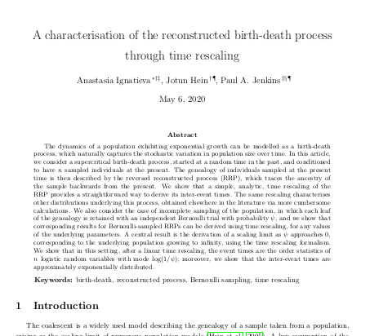
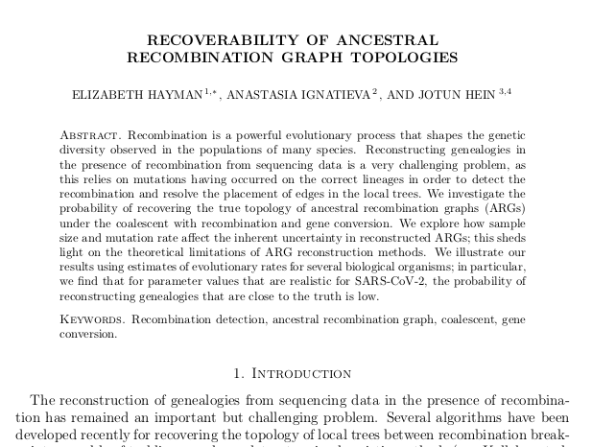
What I did this week
Turned to birth-death processes with recombination: A characterisation of the reconstructed birth-death process through time rescaling (Ignatieva et al.)
Also read Recoverability of Ancestral Recombination Graph Topologies (Hayman et al.)

Slide 4
What I will do next week
Hopefully talk to Ignatieva and/or Hayman about their papers and possible extensions with Professor Hein
Therefore decide a definite topic for my Dissertation project
Read The detection of recombination events using DNA sequence data (Myers) or other relevant papers

